Slide 1
Types of Business Intelligence Tools and Applications
Ad hoc analysis
Online Analytical processing
Mobile BI
Real time BI
Operation Intelligence
Open-Source BI
Embedded BI
Collaborative BI
Location Intelligence
Business intelligence vendors and market
Sehrish Aqeel
www.aisciences.io

Slide 3
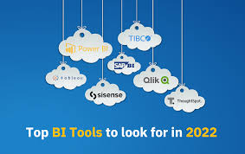
Business Intelligence Vendors and Market

Slide 4
